Slide 1
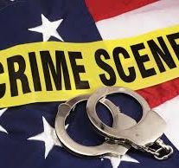
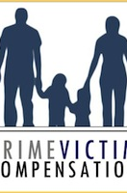
Victims’ Rights and Services
Crime Victims' Bill of Rights
Before the Victims’ Bill of Rights development, the victims were ignored and mistreated by criminal justice systems that seemed more focused on protecting the legal rights of defendants only.
The parole hearings are as a result of the fairness brought about by the Victim’s Bill of Rights (Cassell, 2017).
Congress intervened and made the right policies and laws related to the prisoner. The main in was to promoting fairness and eliminate discrimination of the victims.
Crimes lead to negative impacts on human lives
Types of Victims
The highest rates of victims in Washington, D.C. include:
Washington records the highest number of crimes in all parts of the United States of America.
The crime rates are said to be at least 54 per one thousand residents within Washington, and these numbers are very high compared to the other larger cities (Cassell, 2017).
The crimes rated to property within Washington are very high as compared to crimes due to violence.
The other crimes recorded in Washington State include theft, computer crimes, robbery, and sexual assaults.
Among the factors that lead to high crime rates in Washington States are poor parenting styles, drug and substance abuse, and peer pressure.
Crime Victims’ Compensation Program
In Washington, D.C., the Crime Victims Compensation Program is essential in assisting the families of criminals in funerals, lost wages, and emergency food and shelter.
The maximum compensation given per individual is $ 25,000 (Galvin et al., 2018).
A victim has a right to be treated timeously, courteously, compassionately with respect to their dignity and privacy and taking into account cultural diversity by all investigative, prosecutorial, judicial and victim services agencies.

Slide 2
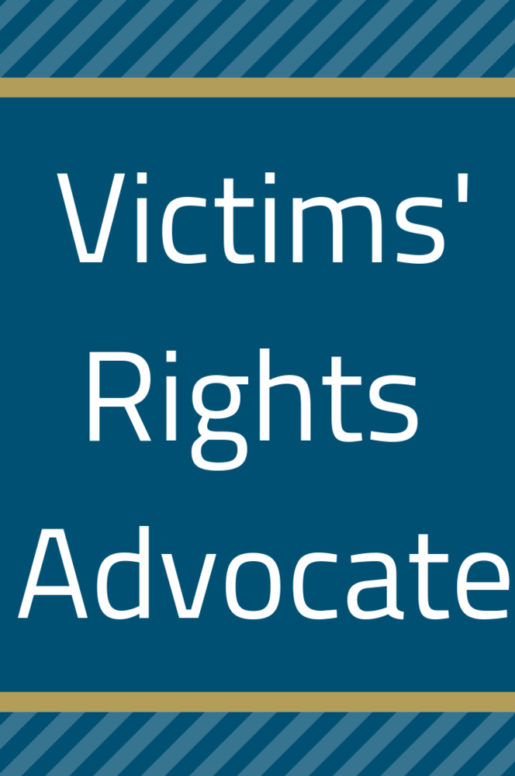
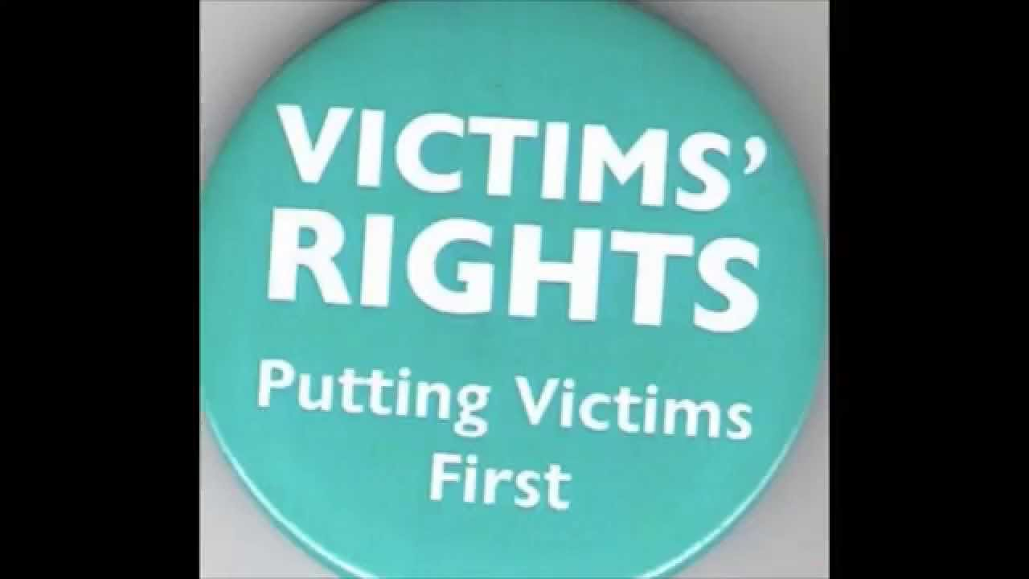
The victims have rights that should be adhered to by all the stakeholders in the judicial and law-enforcement sectors.
.
“Ignorance of the law or unawareness cannot be pleaded to escape liability”
Educating the victims on their rights is of great significand and it has led to transformation of many victims to dependable citizen (Lu et al., 2019).
Example of volunteer organizations in Washington D.C.
The Office of Crime Victims Advocacy (OCVA)
Food for all D.C.
Humane Rescue Alliance’s People and Animal Cardio Klub (Catacalos, 2020).
The Homeless Children’s Playtime Project.
Keeping older people fit through physical exercises.
Advocacy for victims rights is for essential fairness
The OCVA oversees programs and grants for service providers and other professionals who assist victims of crime.
Community Resources
Examples of community resources;
Justice matters for all.
Community health centers.
Advocacy groups.
Counseling services
Recreational centers
Law-enforcement substation
Libraries
Without active overseers justice will never be found in the social settings.

Slide 3
References
Cassell, P. G. (2017). Crime victims' rights. Academy for Justice: A Report on Scholarship and Criminal Justice Reform, Forthcoming.
Catacalos, R. (2020). Black residents navigate an unequal food landscape in Washington, DC. Journal of Agriculture, Food Systems, and Community Development, 9(3), 1-3.
Galvin, M. A., Loughran, T. A., Simpson, S. S., & Cohen, M. A. (2018). Victim compensation policy and white‐collar crime: Public preferences in a national willingness‐to‐pay survey. Criminology & Public Policy, 17(3), 553-594.
Lu, R., Willits, D., Stohr, M. K., Makin, D., Snyder, J., Lovrich, N., ... & Hemmens, C. (2019). The cannabis effect on crime: Time-series analysis of crime in Colorado and Washington State. Justice Quarterly, 1-31.

